Slide 1

IMPLEMENT DEEP LEARNING TECHNIQUES TO DETECT MALARIA USING IBM CLOUD
MINI PROJECT
Presented by:
Puli Kavya (18UK1A05L7)
Machinapally Gayathri(18UK1A05F6)
Majjiga Karthik (18UK1A05K4)
Suthari Pranathi (18UK1A05H5)

Slide 2
INTRODUCTION:
Malaria is a deadly, infectious mosquito-borne disease caused by Plasmodium parasites. These parasites are transmitted by the bites of infected female Anopheles mosquitoes. Typically the ﬁrst symptoms of malaria are similar to the ﬂu or a virus you usually start feeling sick within a few days or weeks after the mosquite bite. However these deadly parasites can live in your body for over a year without any problems! Thus, a delay in the right treatment can lead to complications and even death. Hence early and eﬀective testing and detection of malaria can save lives. It is pretty clear that malaria is prevalent across the globe especially in tropical regions. The motivation for this project is however based on the nature and fatality of this disease. Initially if an infected mosquito bites you parasites carried by the mosquito will get in your blood and start destroy oxygen-carrying RBCs (red blood cells).

Slide 3
ABSTRACT:
Malaria is one of the most devastating infectious diseases of humans. It is problematic clinically and economically as it prevails in poorer countries and regions, strongly hindering socioeconomic development. The causative agents of malaria are unicellular protozoan parasites belonging to the genus Plasmodium. These parasites infect not only humans but also other vertebrates, from reptiles and birds to mammals. To date, over 200 species of Plasmodium have been formally described, and each species infects a certain range of hosts. Plasmodium species that naturally infect humans and cause malaria in large areas of the world are limited to five—P. falciparum, P. vivax, P. malariae, P. ovale and P. knowlesi The range of insect species that can support the critical development of Plasmodium depends on the individual parasite species, but five Plasmodium species causing malaria in humans are transmitted exclusively by anopheline mosquitoes.

Slide 4
PURPOSE :
Nearly half the world’s population is at risk from malaria and there are over 2 million malaria cases and approximately 400,000 deaths due to malaria every year.This gives us all the more motivation to make malaria detection and diagnosis fast,easy and eﬀective. With regular manual diagnosis of blood smears, it is an intensive manual process requiring proper expertise in classifying and counting the parasitized and uninfected cells. Typically this may no scale well and mig cause problems if we do not have the right expertise in speciﬁc regions around the world. Deep Learning models, or to be more speciﬁc, Convolutional Neural Networks (CNNs) have proven to be really effective in a wide variety of computer vision tasks.Automated malaria detection using deep learning models like CNNs could be very effective, cheap and scalable especially with the advent of transfe learning and pre-trained models which work quite well even with constraints like less data.

Slide 5
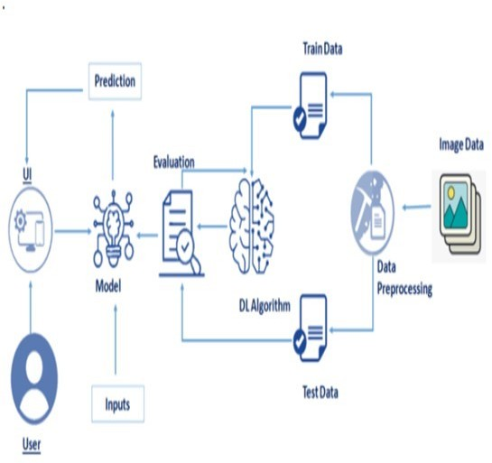
WORK FLOW

Slide 6
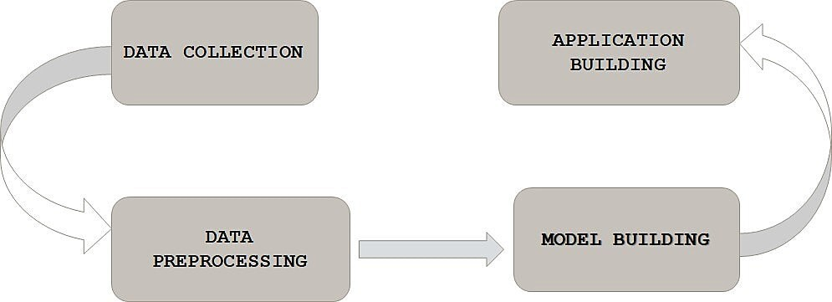
METHODOLOGY

Slide 7
TOOLS AND TECHNOLOGIES :
Importing Libraries
import tensorflow
import tensorflow.keras.layers import Sequential import tensorflow.keras.layers import Dense
import tensorflow.keras.layers import Flatten
import tensorflows.keras.layers import Conv20
import tensorflows.keras.layers import MaxPool20
import tensorflows.keras.layers import Dropout
Initialise
Model=Sequential

Slide 8
IMPLEMENTATION :
CNN MODEL
CNN is a type of neural network model which allows us to extract higher representations for the image content.
Unlike the classical image recognition where you define the image features yourself, CNN takes the image's raw pixel data, trains the model, then extracts the features automatically for better classification.
Similar to how the human brain works, CNN distinguishes meaningful features in an image in order to classify the image as a whole.

Slide 9
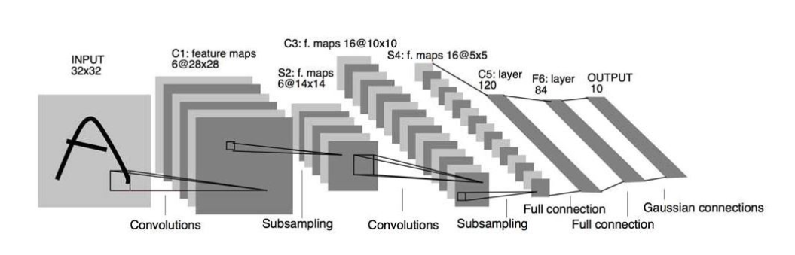
CNN MODEL

Slide 10
CONCLUSION:
Our work shows that the deep learning can be efficiently used to detect malaria parasites on thin blood smears. We have presented a high accuracy DL-based model and tested it on two datasets. The proposed model outperforms or is comparable with the earlier studies. We demonstrated that to achieve a high accuracy one does not have to use very deep neural networks and more shallow versions maybe preferable. We have relabelled wrongly classified images in the dataset. By testing on two different datasets we have confirmed the limitations of the model. More work need to be done to build a deep learning model which would be able to distinguish between true parasites, impurities and artefacts in the way a human expert would do. However, the model presented allows identification most of cases correctly. It can be treated as the first AI-based step which is able to detect if a blood cell is highly likely to contain a parasite, faster and more accurately than manual testing. More detailed analysis of a suspicious region, either by an expert or by a new deep learning method, is required.

Slide 11
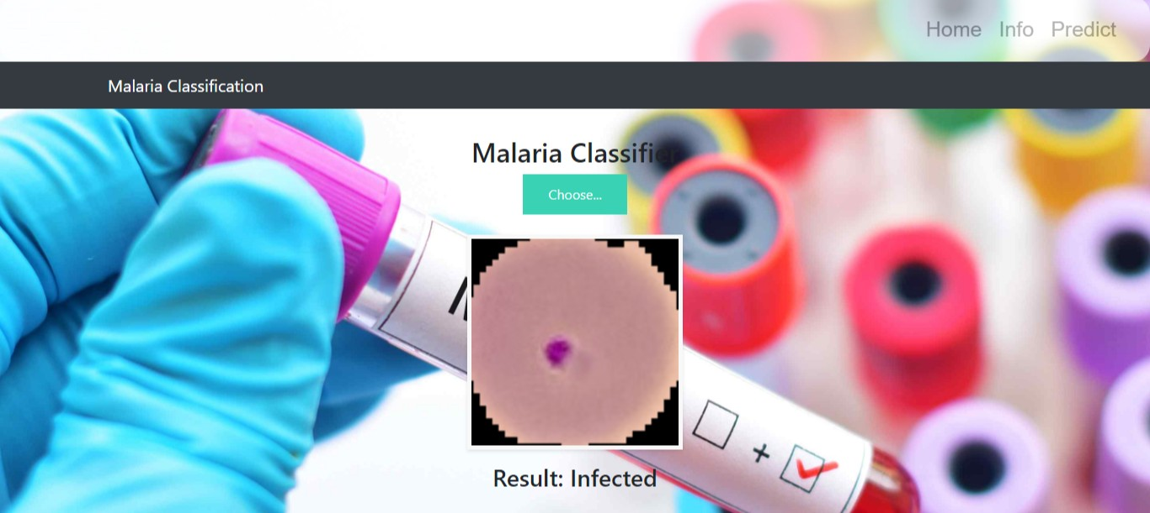
RESULT :

Slide 12
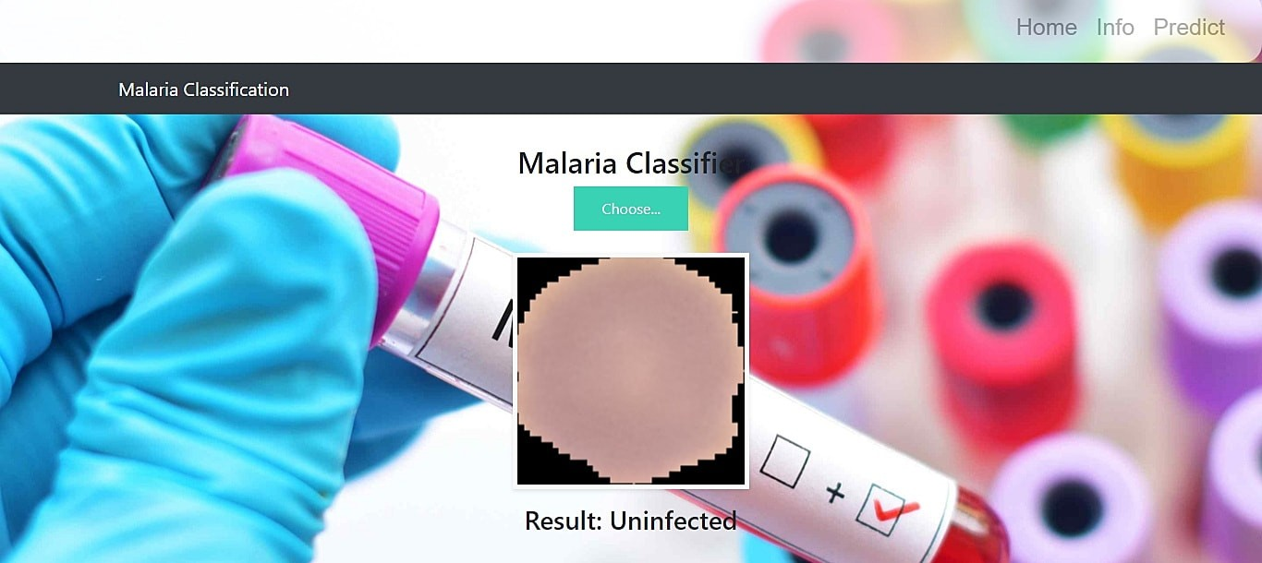

Slide 13
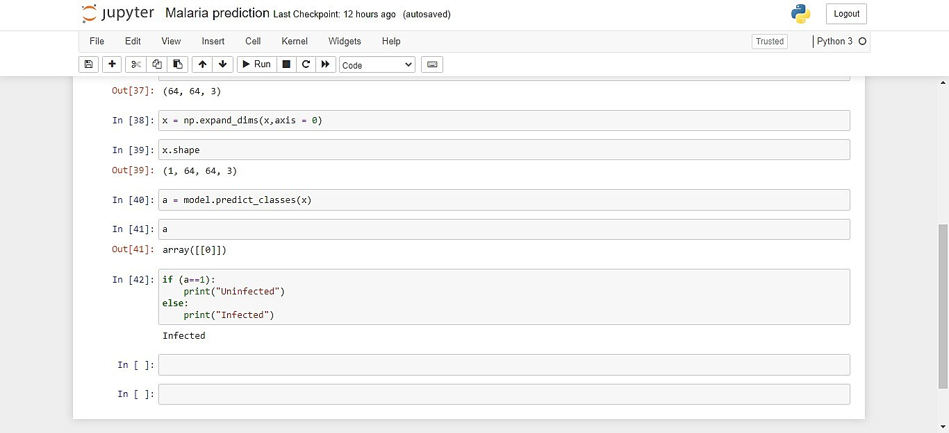

Slide 14
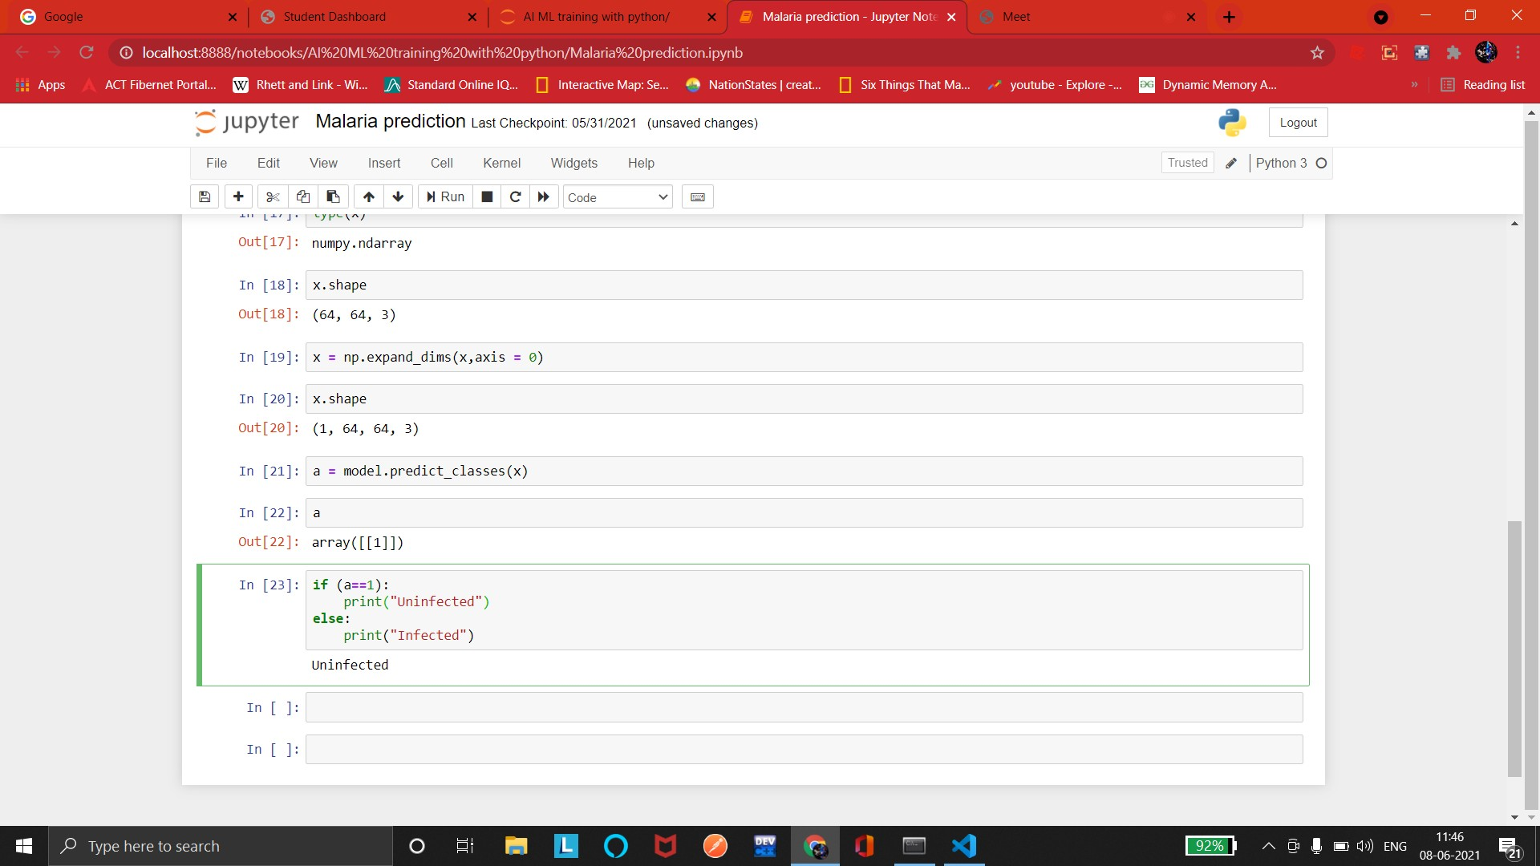

Slide 15
ADVANTAGES:
Automated malaria detection using deep learning models like CNNs could be very effective, cheap and scalable especially with the advent of transfer learnin and pretrained models which work quite well even with constraints like less data.
It reduces images to a form which is easier to process without losing features which are critical.Image pre-processing required is much less compared to oth algorithms.
Deep learning does not require the design of handcrafted features, which is o of its biggest advantages

Slide 16
DISADVANTAGES:
There has been a lot of ﬁne-tuning of these methods to make them perform better for blood smear images, and more so for the image analysis methods than for machine learning.
Despite the large number of publications, the performance numbers that have been published are very unsatisfying from a clinician’s point of view.
It requires a large training data.
It requires appropriate model.

Slide 17
APPLICATIONS:
There has been a lot of ﬁne-tuning of these methods to make them perform better for blood smear images, and more so for the image analysis methods than for machine learning.
There is certainly the potential that some of these methods gain importance outside malaria diagnosis, in particular for preprocessing and for detecting an segmenting red blood cells in other applications.
Working on this project lead us to believe that this work can play a part toward building a fully automated system for malaria parasite detection which may be useful in resource-constrained areas in the foreseeable future.
The same methods used in this project , can help In medical science, by making more models to work for many other diseases diagnoses. With this, medical technology can grow faster and be able to build 3D models that can predict accurately.

Slide 18
THANK YOU

